Slide 1
AI Text-To-Image Generator
From Code To Creativity
Priyanshi Bansal

Slide 2
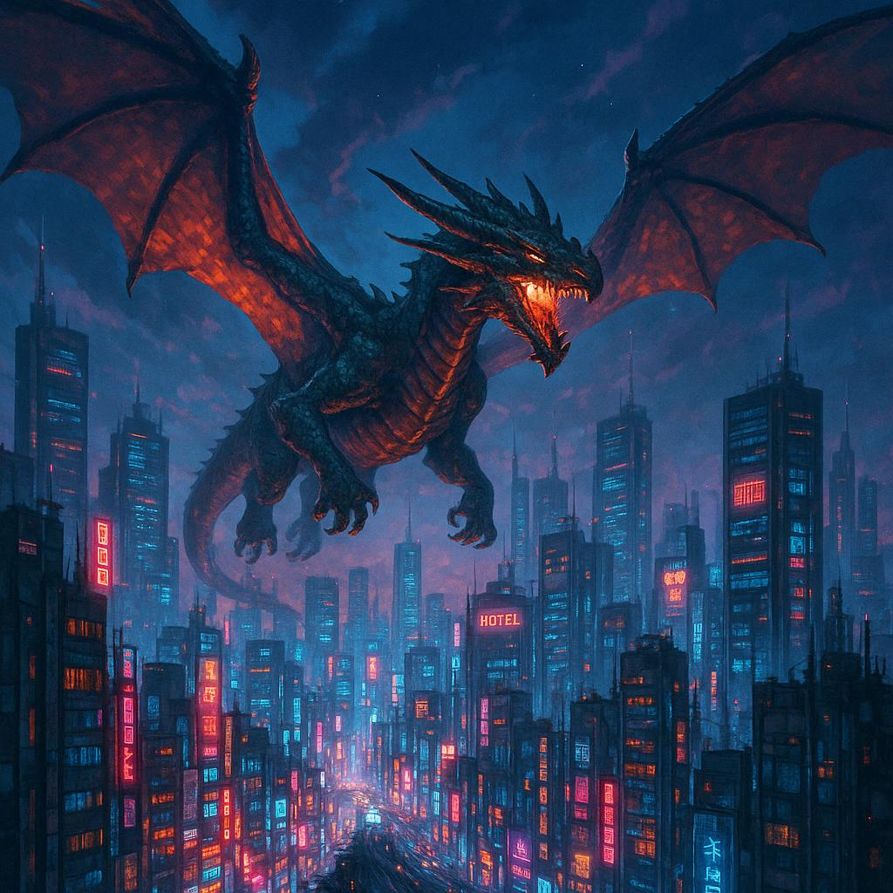
What is AI Text-To-Image Generator ?
An AI text-to- image generator is a type of artificial intelligence that creates images based on written text prompts. Using advanced deep learning models trained on large datasets of images and descriptions, the AI interprets language and generates visuals that match the prompt. It is widely used in design, marketing, education, and creative industries to quickly produce high quality, custom visuals without the need for traditional artistic skills.

Slide 3
Coding objectives
The primary objective of an AI Text-To-Image generator is to create realistic and compelling images from textual descriptions, effectively bridging the gap between language and visual representation.
Understanding Textual Prompts
Input
Natural language processing (NLP)
Feature extraction
Image Generation
Model selection
Latent space representation
Image synthesis
Refinement
Output And Evaluation
Image display
Feedback loop
Evaluation metrics
Application And Benefits
Creative expression
Content creation
Design and visualization
Accessibility
Education and training
Revolutionizing industries

Slide 4



Tools behind the magic
1. LIBRARIES
PyTorch
TensorFlow
Hugging Face Transformers

Slide 5

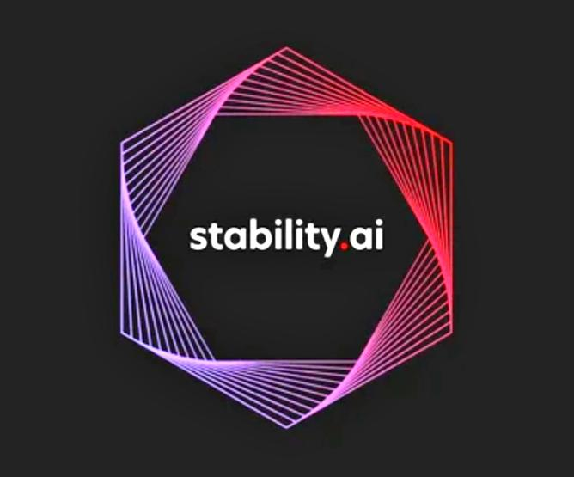
2. APIs
OpenAI’s DALL-E
Stability AI’s Stable Diffusion

Slide 6


3. CLOUD
Google Colab
AWS For GPU Support

Slide 7
Popular models
GAN’s
CLIP
Diffusion models
Generative Adversarial Networks
Type of generative models.
They provide a faster inference.
They generate high quality, realistic data.
Contrastive language Image Pre-training
It is a multimodal model.
It is much more efficient and achieves accuracy 10x faster
It significantly outperforms other classifiers
Stable diffusion
Type of generative model.
They have slow inference speed compared to other generative models.
They generate high quality data

Slide 8
Implementation steps
🧠 1. Understand the Architecture Choose or understand the architecture you’ll be working with: Popular Architectures: DALL·E / DALL·E 2 – VQ-VAE + Transformer (DALL·E 1), CLIP guidance (DALL·E 2) Stable Diffusion – Latent diffusion models with CLIP for conditioning Imagen (Google) – Text-conditioned diffusion models with T5 encoder
🔧 2. Collect and Prepare Data
You need a large dataset of images and associated textual descriptions.
Datasets: LAION-5B – Open dataset with image-text pairs COCO – Captions and labeled images Conceptual Captions – Image-caption pairs from the web

Slide 9
Preprocessing: Normalize images (resize, standardize) Tokenize text prompts using a tokenizer (e.g., BPE or T5 tokenizer)
🏗️ 3. Choose a Model and Framework Frameworks: PyTorch (widely used in research) TensorFlow/Keras (good for production) JAX/Flax (used by Google, efficient for training at scale)
Model Components: 1. Text Encoder (e.g., CLIP, T5, BERT) 2. Image Decoder / Generator VQ-VAE for discrete latent space Diffusion model for gradual denoising in latent space

Slide 10
3. Conditioning Mechanism Cross-attention between text and image tokens
🧪 4. Inference Pipeline Once trained, implement the generation process: 1. Tokenize the input text. 2. Encode text into embeddings. 3. Use a diffusion or transformer decoder to generate image latents. 4. Decode latents to image using the VAE decoder.
Snippet –
From diffusers import StableDiffusionPipeline import torch pipe = StableDiffusionPipeline.from_pretrained(“runwayml/stable-diffusion-v1-5”) pipe = pipe.to(“cuda”) image = pipe(“a futuristic cityscape at sunset”).images[0] image.show()

Slide 11
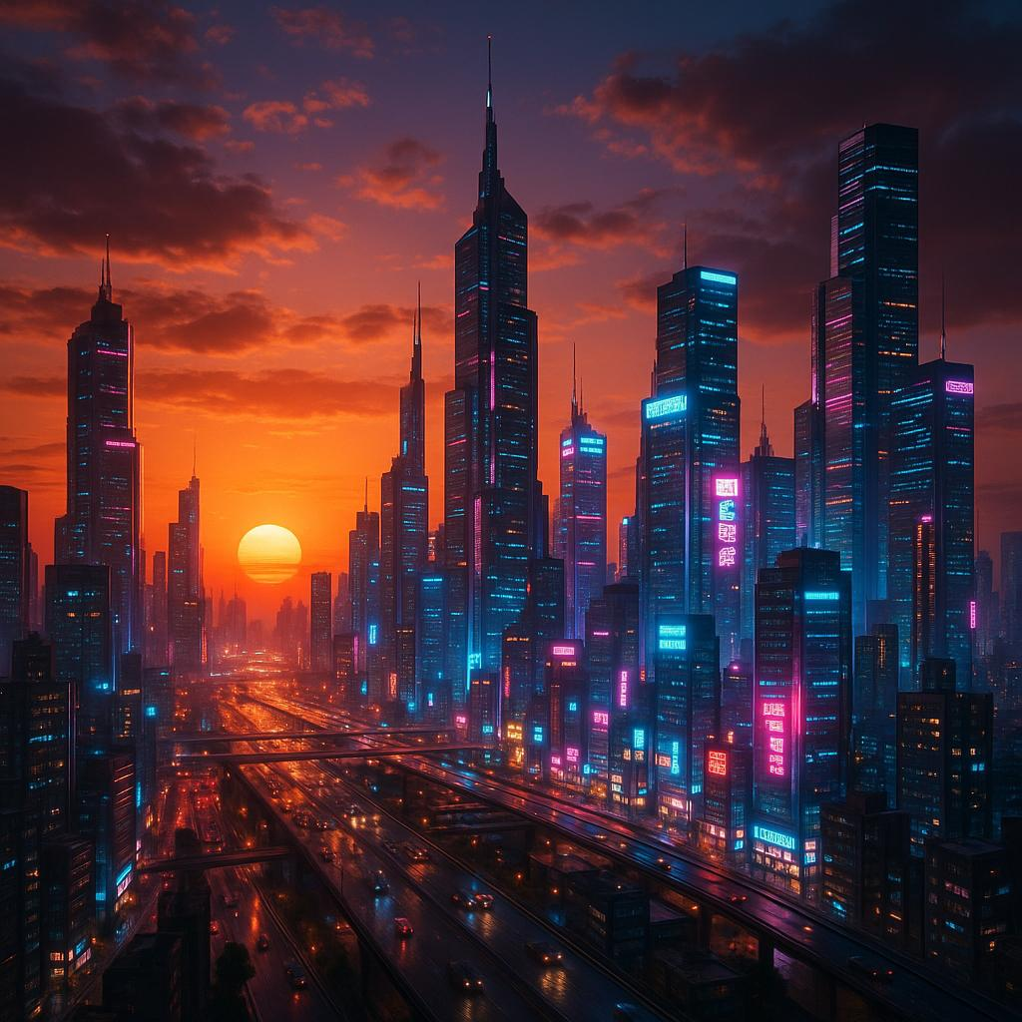
Crafting effective prompts
Prompt Engineering
Prompt Engineering is the process of crafting effective instructions (prompts) to guide generative AI models,like large language models (LLMs), to produce desired output.
✓ Photorealistic –
“ A futuristic city at sunset, neon
Lights, ultra-realistic.”

Slide 12
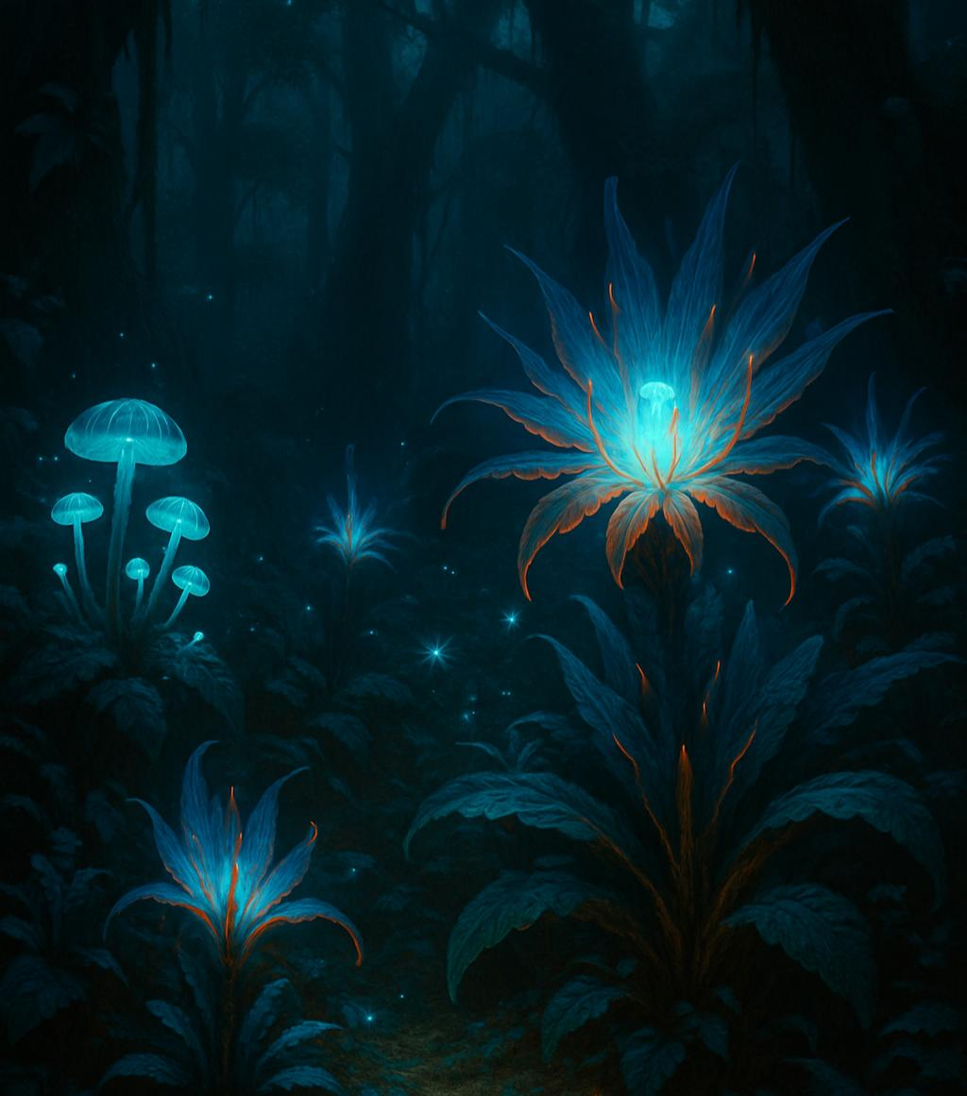
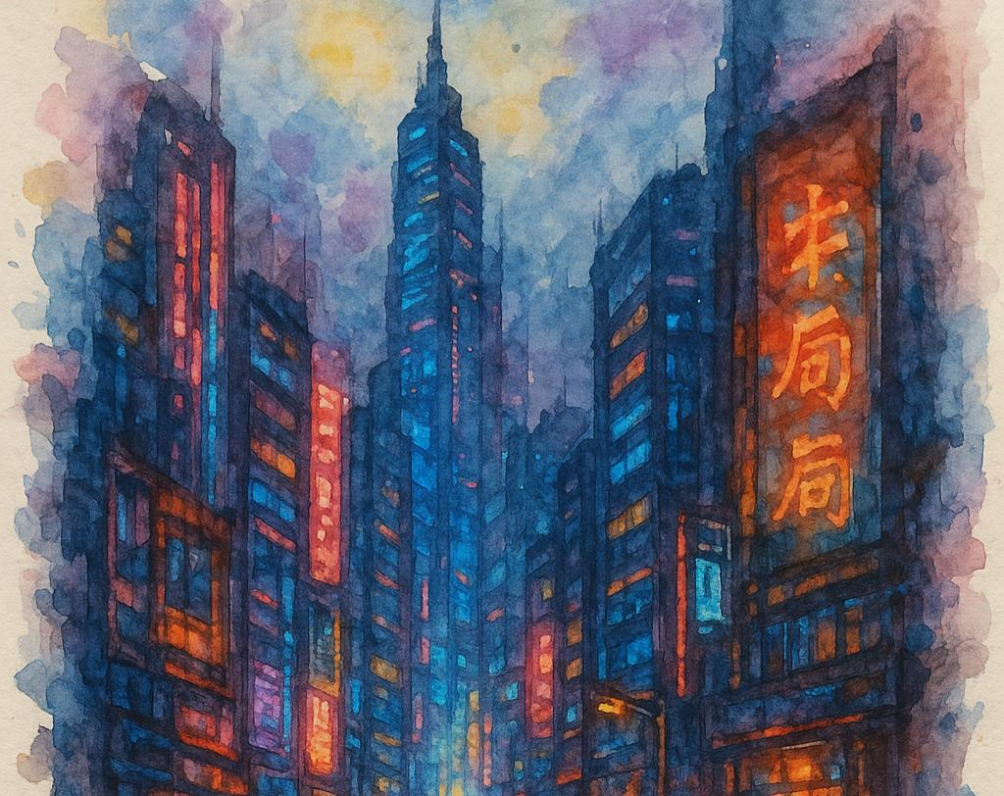
✓ Fantasy and sci-fi –
“Alien jungle with glowing plants,
high details “
✓Art Styles –
“Cyberpunk street in watercolor
Style”

Slide 13
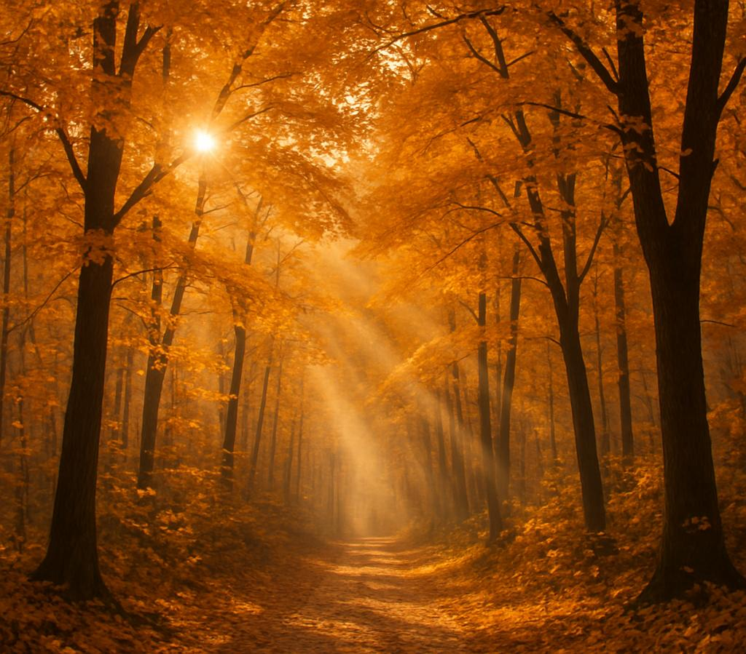
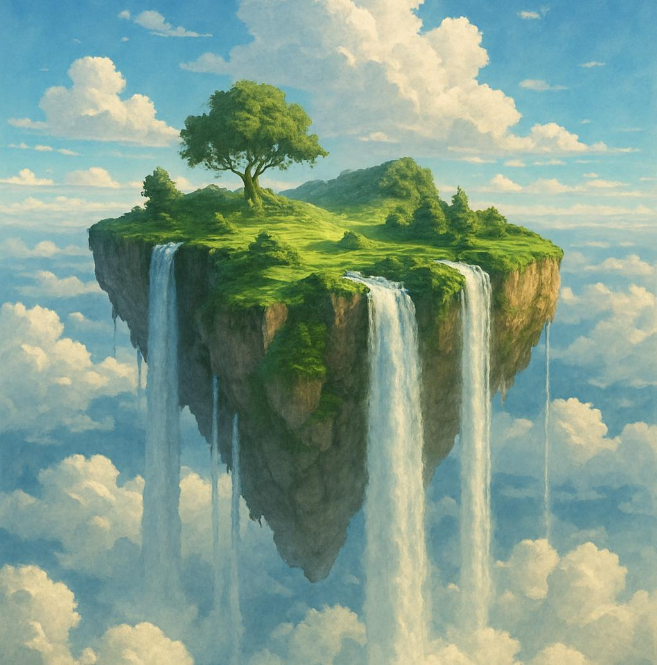
✓Nature and landscape –
“Autumn forest path with golden leaves
And sunrays “
✓Surreal and abstract –
“A floating island in the sky with waterfalls
Falling into clouds “

Slide 14
Challenges and ethics
CHALLENGES :-
Text Ambiguity – Misinterpretation of prompts.
Visual Accuracy – Incorrect object placement or context.
Data Bias – Trained on biased or incomplete datasets.
Computational Cost – High GPU & energy usage.
Control & customisation – Limited fine tuning in output.

Slide 15
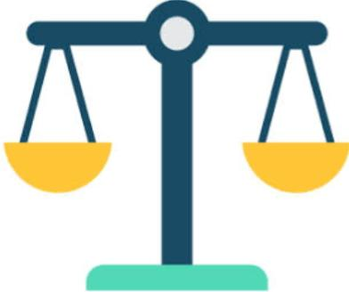
ETHICAL CONSIDERATIONS:-
Copyright infringement – Risk of mimicking real artists styles.
Deepfakes & misinformation – Potential for misuse in fake content.
Bias amplification – Reinforcing stereotypes or exclusion.
Consent & data privacy – Use of scrapped image without permission.
Accessibility & equity – Unequal access to powerful tools.

Slide 16
Resources and citations
Academic & Technical References
Tool | Description | Reference / Link
DALL·E 3 (by OpenAI) | High-quality image generation from text. Integrated into ChatGPT Plus. | DALL·E on OpenAI
Midjourney | Known for artistic and detailed imagery. Works via Discord bot. | Midjourney Website
Stable Diffusion (by Stability AI) | Open-source model; used in many custom apps. Highly customizable. | Stable Diffusion GitHub
Adobe Firefly | Designed for creative professionals; offers control over styles. | Adobe Firefly
Runway ML | Offers text-to-image and video generation tools. | Runway
Leonardo.Ai | Easy-to-use creative suite with powerful prompt controls. | Leonardo.Ai
Dream by Wombo | Mobile-friendly, simple to use, with various styles. | Dream by Wombo
Craiyon (formerly DALL·E mini) | Free and lightweight, good for quick concepts. | Craiyon

Slide 17
Conclusion
Impact on artists and designers
ARTISTS
DESIGNERS
They can work much faster because the machine will generate their work quickly.
It gives them a wide variety of insights.

Slide 18
The future of Ai creativity
It is possible to create completely original, High quality images with minimal effort
Endless possibilities for creating unique, high quality images that can be used for a variety of purpose
Why AI image Generation is the future?
The technology behind AI generation is constantly improving
AI image Generation is a rapidly developing field

Slide 19
Thank You

